Slide 1
ATRIAL FIBRILLATION

Slide 2
ABSTRACT
Atrial Fibrillation (AF) is a prevalent cardiac arrhythmia that poses significant risks, including stroke and heart failure. Timely detection of AF is crucial for effective management and prevention of complications. This paper presents a novel system for AF detection using Convolutional Neural Networks (CNNs) applied to Electrocardiogram (ECG) signals. The proposed method involves transforming raw ECG data into 2D spectrograms to capture essential features indicative of AF. A CNN model is trained on these spectrograms to learn and identify patterns associated with AF episodes accurately. Experimental results demonstrate that the CNN-based approach achieves high sensitivity and specificity, outperforming traditional methods. The proposed system aims to enhance AF detection in real-time, providing a valuable tool for healthcare professionals and improving patient outcomes.

Slide 3
INTRODUCTION
Atrial Fibrillation (AF) is one of the most common cardiac arrhythmias affecting millions of people worldwide.
It is characterized by irregular and rapid heart rhythms.
AF can lead to serious complications such as stroke, heart failure, and increased mortality.
Electrocardiogram (ECG) is a widely used diagnostic tool to monitor the electrical activity of the heart.
Early detection of AF is very important for effective treatment and prevention of complications.

Slide 4
Atrial Fibrillation Detection using Deep Learning
Traditional AF detection mainly depends on manual interpretation of ECG signals by
doctors.
This process can be time-consuming and prone to human errors.
Recent advancements in Deep Learning techniques provide automated solutions
for AF detection.
Convolutional Neural Networks (CNN) can learn patterns from ECG signals and identify
AF accurately.
ECG signals can be converted into 2D representations such as spectrograms or
wavelet transforms for better feature extraction.
This approach helps in real-time monitoring and improved diagnosis of AF.

Slide 5
OBJECTIVES
To develop an automated system for detecting Atrial Fibrillation (AF) using ECG signals.
To apply Convolutional Neural Networks (CNN) for accurate classification of AF and normal heart rhythms.
To convert ECG signals into 2D spectrogram representations for better feature extraction.
To improve the accuracy and efficiency of AF detection compared to traditional methods.
To support early diagnosis and real-time monitoring of heart conditions.

Slide 6
LITERATURE
Recent studies show that Deep Learning techniques are effective in detecting Atrial Fibrillation (AF) from ECG signals.
Rajpurkar et al. (2017) developed a CNN-based model that analyzed raw ECG data and achieved high sensitivity and specificity.
Asgari et al. (2015) compared machine learning algorithms such as SVM, Random Forest, and KNN for AF detection.
These traditional methods required manual feature extraction, which sometimes failed to capture complex ECG patterns.
Researchers suggested that CNN models can automatically extract features, improving detection accuracy.

Slide 7
LITERATURE
Oster et al. (2018) studied AF detection using wearable devices like
smartwatches for real-time monitoring.
Yildirim et al. (2019) improved AF detection by converting ECG signals
into images and applying CNN models.
Guglielmo et al. (2020) highlighted challenges such as data imbalance
and dataset quality in machine learning models.
Xu et al. (2023) used transfer learning to improve CNN performance
on different ECG datasets.
Overall, studies show that CNN-based methods provide more accurate
and automated AF detection compared to traditional techniques.

Slide 8
Existing System
Current AF detection systems use wearable medical devices to monitor
heart activity continuously.
These devices include components such as 1-lead ECG sensor, ARM
processor, Bluetooth module, SD card, and rechargeable battery.
ECG signals are collected and processed using digital filtering and the
Tompkins algorithm to detect P-wave presence and heart rate variability.
Artificial Neural Networks (ANN) are used to classify heart conditions based
on extracted ECG features.
The system is trained using ECG datasets such as the MIT/BIH Atrial
Fibrillation Database.
These wearable systems help in early detection of AF and provide
support for cardiologists in monitoring patients’ heart health.

Slide 9
PROPOSED SYSTEM
The proposed system uses Convolutional Neural Networks (CNN) to automatically
detect Atrial Fibrillation (AF) from ECG signals.
Wearable ECG devices continuously collect real-time heart data from patients.
The ECG signals are preprocessed to remove noise and divided into smaller segments.
Each ECG segment is converted into a 2D spectrogram for better feature analysis.
The CNN model is trained using spectrogram datasets to learn patterns related to AF.
The system can classify ECG signals in real-time and detect AF with high accuracy.
Results are displayed through a user-friendly interface and can be stored in
cloud systems for remote monitoring.

Slide 10
SYSTEM REQUIREMENTS
HARDWARE REQUIREMENTS
Hard Disk : 1000 GB
Monitor : 15 VGA color
Mouse : Microsoft.
Keyboard : 110 keys enhanced
RAM : 4GB
Processor : Intel i3/i5/i7
Hard disk : 160 GB
Monitor : 18inch Lcd/Led

Slide 11
SOFTWARE REQUIREMENTS
OS: Windows 8/10/11
Editor: VS Code
Python 3.7
Python with its neural network libraries
Front end: HTML
Backend: Django

Slide 12
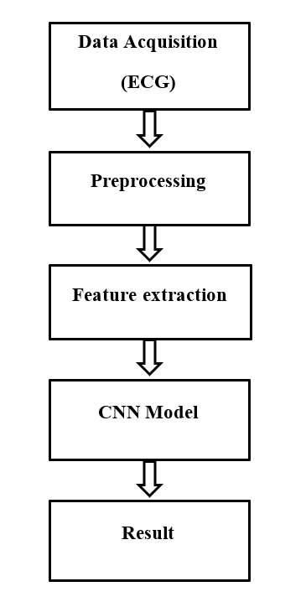
BLOCK DIAGRAM

Slide 13
Modules
Data Acquisition Module
Data Preprocessing Module
Feature Extraction Module
CNN Model Training Module
AF Detection / Classification Module
Result Display and Monitoring Module

Slide 14
Module Description
1. Data Acquisition Module
Collects ECG signals from wearable devices or ECG datasets.
Provides real-time heart activity data for analysis.
2. Data Preprocessing Module
Removes noise and unwanted signals using filtering techniques.
Segments ECG signals into smaller intervals for processing.
3. Feature Extraction Module
Converts ECG signals into 2D spectrogram or wavelet images.
Extracts important time and frequency features from ECG data.

Slide 15
Module Description
4. CNN Model Training Module
Trains the CNN model using labeled ECG datasets.
Helps the system learn patterns of normal and AF signals.
5. AF Detection / Classification Module
Classifies ECG signals as Normal or Atrial Fibrillation.
Uses the trained CNN model for accurate detection.
6. Result Display and Monitoring Module
Displays ECG results and AF detection output to users.
Sends alerts for early diagnosis and monitoring.

Slide 16
Future Enhancement
Integrating the system with wearable devices and smartwatches for
continuous heart monitoring.
Improving the model accuracy using larger ECG datasets and advanced deep
learning algorithms.
Developing a mobile application to display ECG results and AF alerts in real time.
Implementing cloud-based storage for secure data management
and remote monitoring by doctors.
Expanding the system to detect other heart diseases and arrhythmias
in addition to AF.

Slide 17
CONCLUSION
The proposed system uses Convolutional Neural Networks (CNN) to
detect Atrial Fibrillation (AF) from ECG signals automatically.
Converting ECG signals into 2D spectrograms helps the model identify important
patterns related to AF.
The system provides accurate and efficient AF detection, improving diagnosis
compared to traditional methods.
This approach can support real-time monitoring and early detection, helping
healthcare professionals provide better treatment and patient care.

Slide 18
REFERENCES
Bhavnani, S. P., Narula, J., & Sengupta, P. P. (2016). Mobile technology
and the digitization of healthcare. European Heart Journal.
Camm, A. J. et al. (2010). Guidelines for the management of atrial fibrillation.
European Heart Journal.
Ghodrati, A., Murray, B., & Marinello, S. (2008). RR interval analysis for detection
of atrial fibrillation in ECG monitors. IEEE Conference.
Goldberger, A. L. et al. (2000). PhysioBank, PhysioToolkit, and PhysioNet.
Circulation Journal.
Gotlibovych, I. et al. (2018). Deep learning from raw sensor data for AF
detection using wearables.
Lau, J. K. et al. (2013). iPhone ECG application for AF screening.
International Journal of Cardiology.

